Slide 1

Diversity in Tech Carlos Ruiz, Paris Lee, Daniel Purrier, Neyda Morales June 10, 2024

Slide 2
Agenda
Introduction
Research Questions
Linear/Statistical Modeling
Bias and Limitations
Future Work
Call to Action
Works Cited
Q&A

Slide 3

Thesis: The world is constantly growing and becoming increasingly diversified; thus, the analysis of this dataset will allow us to explore whether or not this global diversity is reflected in tech workforces.

Slide 4
Research Question 1
Has racial diversity in the tech workplace increased over time?
Leaderboards/Visualizations
Line chart

Slide 5
Research Question 2
What is the percentage of males vs females in the tech workplace over time?
Leaderboards/Visualizations
Double bar chart
Donut chart

Slide 6
Research Question 3
Which racial group has seen the most growth between 2014 – 2018?
Leaderboards/Visualizations

Slide 7

Linear / Statistical Modeling

Slide 8
Regression
Are companies that hire more Women more likely to hire Latinos/Blacks? (Regression)

Slide 9
violin

Slide 10

Bias and Limitations
Small list of companies
Company size not included
Recent years not included
Raw data not included (only percentages)
Intersectional data points not included (ex: Latino female population, Black Male population)

Slide 11


Future Work
Study locations, income levels, access to education

Slide 12



Call to Action
Outreach to inner city schools
Tech programs for kids in different demographics

Slide 13
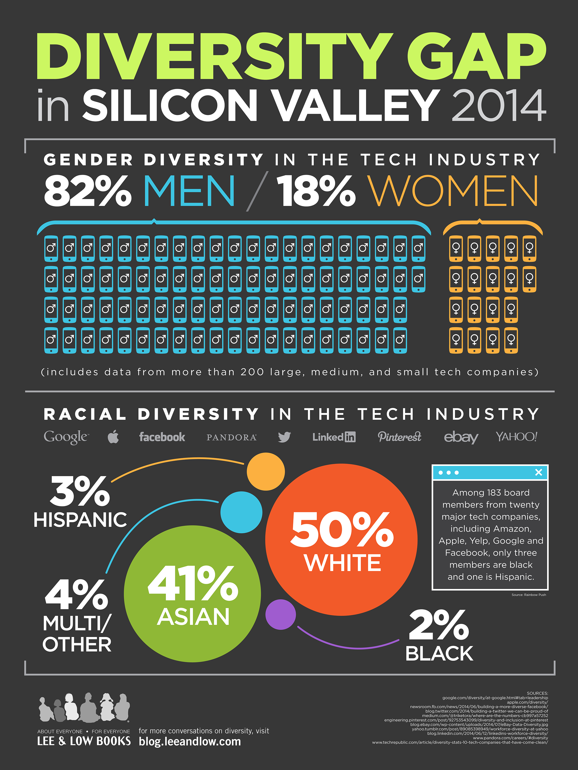
Works Cited
https://www.kaggle.com/datasets/jainaru/diversity-in-tech-companies/data
https://blog.leeandlow.com/2015/03/12/the-diversity-gap-in-silicon-valley/
https://hussellvs.best/product_details/69890865.html
insert

Slide 14

Thank you
Questions?

